Slide 1

NetSage AI
An AI-Assisted Network Troubleshooting System with Human Review

Slide 2

The Troubleshooting Gap
Connecting Symptoms to Causes
Junior engineers frequently possess knowledge of individual Cisco networking commands but often struggle to connect an observed network symptom with its underlying root cause.
Modern enterprise networks have interdependent components where one symptom (e.g., unreachable IP) can map to multiple fault domains. NetSage AI bridges this gap by systematizing evidence collection and diagnosis into a repeatable workflow.

Slide 3
Challenges in Network Operations
OSI Layer Mapping: Engineers frequently struggle to map an observed symptom directly to the correct OSI layer (e.g., Layer 2 VLAN issues versus Layer 3 Gateway misconfigurations).
Overlapping Symptoms: It is exceptionally difficult to distinguish between overlapping causes, such as a DHCP failure and a routing misconfiguration presenting identical end-user symptoms.
AI Hallucinations: Blindly trusting AI output in technical networking can lead to further, more severe misconfiguration if the model invents plausible but factually incorrect facts.
Pattern Recognition: A lack of structured ways to record, review, and learn from diagnostic reasoning limits the pedagogical value of standard troubleshooting exercises.

Slide 4
Problem Statement
Design and implement a Python-based, AI-assisted network troubleshooting system that requires a human reviewer to accept, edit, or reject every generated diagnosis before it is treated as final.
"
"
— Sabhya Anand, NetSage AI Project Definition

Slide 5

Proposed Solution: NetSage AI
Augmenting Engineer Judgment
NetSage AI is an advanced Python-based system that combines deterministic rule checking with an AI-oriented diagnosis layer. Every diagnosis is treated strictly as a recommendation subject to mandatory human review.
This architecture emphasizes Responsible AI in technical operations, ensuring that the system supports the systematic diagnosis of network faults without removing the learner's responsibility for the final, authoritative decision.

Slide 6






Core System Architecture
Rule Checker
Diagnosis Engine
Review Log
Applies a fixed set of robust if-then conditions to structured Cisco IOS input in order to produce deterministic conclusions for known network anomalies.
Synthesizes broad evidence into a candidate explanation (Root Cause, OSI Layer, Confidence, Remediation) strictly formatted using a JSON schema.
Provides a permanent, structured audit trail of all Accepted, Edited, or Rejected decisions to support future evaluation of AI-human agreement.

Slide 7
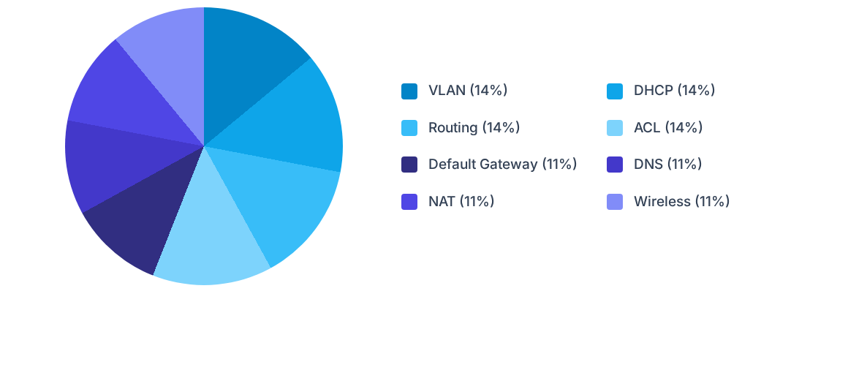
The Troubleshooting Dataset (36 Cases)
The curated dataset comprises 36 Packet Tracer-style cases spanning multiple fault domains, meticulously designed to provide a comprehensive baseline for testing diagnostic accuracy and engine performance.

Slide 8


Deterministic Rule Checker
Pattern Recognition
Transparent Evidence
The Python-based rule checker evaluates Cisco show-command outputs against eleven specific deterministic patterns. This includes detecting 'administratively down' interfaces, missing VLANs, ACL implicit denies, and DHCP pool exhaustion through explicit textual footprint matching.
Each detected pattern immediately generates a structured finding object. This finding isolates the core issue, assigns a severity level, highlights the exact text evidence found in the device output, and provides actionable, step-by-step remediation commands.

Slide 9
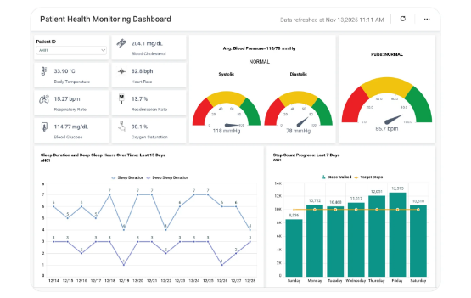
AI-Oriented Diagnosis Layer
•
Evidence Synthesis: Intelligently combines symptoms, topology notes, and rule-checker findings into a comprehensive candidate explanation.
•
Strict JSON Schema: Mandates output in a highly structured format including Root Cause, precise OSI Layer, Confidence, and Fix Steps.
•
Built-In Oversight: Explicitly flags the requirement for human verification within the payload to enforce accountability.
•
Interchangeable Design: The robust architecture supports both the current mock/rule-assisted engine and future live Large Language Model (LLM) API calls seamlessly.

Slide 10
The API Quota Challenge
429
Adapting with Integrity
During integration testing, live OpenAI-compatible LLM API calls consistently returned insufficient quota limits. Rather than fabricating AI performance results, the system was responsibly adapted.
HTTP Rate Limit Error
A mock/rule-assisted engine was implemented that perfectly preserves the JSON output contract. This demonstrates the end-to-end workflow accurately, ensuring complete transparency and adherence to Responsible AI principles.

Slide 11


Why Human-in-the-Loop (HITL)?
Mitigating AI Risk
Enabling Active Learning
Large Language Models are prone to generating fluent but factually incorrect explanations (hallucinations). HITL design acts as an essential operational firewall, ensuring a person with deep contextual understanding validates technical recommendations before they impact network stability.
By forcing the network engineer to review, accept, or edit the diagnosis, they remain the final decision-maker. This actively accelerates pattern recognition and learning without dangerously offloading critical thinking responsibility to an automated system.

Slide 12

The Review Workflow
Accountable Decisions
The Streamlit-based interface presents the generated diagnosis alongside all supporting rule-based evidence. Reviewers must manually and consciously select from three distinct outcomes: Accepted, Edited, or Rejected.
All finalized decisions, including manual edits and free-text reviewer notes, are permanently persisted to a CSV log. This practice generates a rich, auditable dataset to support future granular analysis of AI-human agreement rates and system efficacy.

Slide 13
Responsible AI in Action
Prioritizing foundational transparency, evidence-based reasoning, and accountable human oversight over unchecked, hazardous automation.

Slide 14
Responsible AI Principles Applied
Transparency: Clearly disclosing system limitations (such as the API quota constraint) and mapping how conclusions are reached, rather than presenting AI as an infallible black box.
Evidence-Based Reasoning: Grounding every diagnosis deeply in verifiable show-command data. The AI engine is strictly prompted to utilize provided context, not invent network configurations.
Auditability: Maintaining a permanent, immutable log of every human override. This historical data is crucial for identifying systemic weaknesses in the underlying diagnosis logic over time.
Ethical Automation: Intentionally designing the tool to augment the junior engineer's capabilities and learning process, instead of replacing their critical thinking and technical agency.

Slide 15
Implementation & Testing
•
Built using a highly robust tech stack including Python, Pandas, and Streamlit to create an interactive web-based dashboard environment.
•
Features a strictly modular architecture, separating the Dataset, Rule Checker, Diagnosis Engine, and Human Reviewer into distinct, easily maintainable components.
•
Validated via dedicated unit test scripts for dataset integrity, ensuring 36 rows with unique case IDs and flawless, deterministic rule logic matching.
•
The Streamlit application underwent extensive manual exploratory validation to guarantee smooth data flow across the Home, Diagnose, Review, and Dashboard pages.

Slide 16
Case Study: Gateway Mismatch (CASE003)
Field | Detail
Network Problem | A user's PC obtains an IP address via DHCP but cannot reach the default gateway.
System Diagnosis | Root cause correctly identified as a Gateway mismatch at OSI Layer 3.
Human Decision | Edited
Lesson Learned | The reviewer noted a subnet mask inconsistency in the topology. This demonstrates that human review successfully catches secondary, nuanced faults that are easily missed by basic rule logic.

Slide 17
Case Study: Ambiguous Evidence (CASE026)
Field | Detail
Network Problem | Internal corporate hosts cannot access an external web server post-NAT change.
System Diagnosis | Root cause inaccurately identified as a NAT configuration problem at OSI Layer 3.
Human Decision | Rejected
Lesson Learned | The actual cause was an ACL blocking outbound traffic. Human judgment successfully resolved competing evidence that tricked the simplified, automated rule hierarchy.

Slide 18






Core Project Achievements
End-to-End Workflow
Robust Dataset
Interchangeable Engine
Curated a comprehensive, structured 36-case dataset spanning 8 distinct fault categories and multiple OSI layers, exceeding the initial project requirements.
Successfully delivered a complete, working pipeline from case input and deterministic rule checking to human-reviewed diagnosis logging via an interactive dashboard.
Engineered a decoupled JSON schema that allows the UI to seamlessly switch between the mock engine and a future live LLM without requiring major refactoring.

Slide 19
Future Scope Roadmap
Phase 2: RAG Grounding
Phase 4: Analytics
Implement Retrieval-Augmented Generation using official Cisco networking documentation to ground AI conclusions firmly in verified facts.
Deploy advanced, visually rich analytics to evaluate historical AI-human agreement rates and confidence-versus-correctness metrics.
Phase 1: LLM APIs
Phase 3: Live Polling
Integrate a real Large Language Model (LLM) API for advanced technical reasoning once billing quota constraints are fully resolved.
Connect directly to physical or virtual network devices via SSH to automate the extraction and parsing of live show-command telemetry.

Slide 20
Conclusion & Q&A
Thank you for your attention.
Sabhya Anand Applied AI and Network Troubleshooting | IILM University

Slide 21






Image Sources
https://images.stockcake.com/public/5/f/5/5f5944ad-cb0a-4edf-bd60-ed8a42201021_medium/digital-neural-network-stockcake.jpg
Source: stockcake.com
https://img.magnific.com/premium-photo/flat-abstract-ai-brain-with-digital-nodes-isolated-white-background-concept-as-stylized-abst_980716-676059.jpg?semt=ais_hybrid&w=740&q=80
Source: www.magnific.com
https://www.boldbi.com/wp-content/uploads/2025/12/patient-health-monitoring-dashboard-v2.webp
Source: www.boldbi.com
https://images.stockcake.com/public/4/0/3/403f31a1-9957-4c51-9808-b457842479bf_medium/analyzing-business-data-stockcake.jpg
Source: stockcake.com
https://www.protechtraining.com/sites/default/files/2021-04/AdobeStock_317757317.jpeg
Source: www.protechtraining.com
https://img.magnific.com/free-vector/abstract-blue-gradient-color-technology-line-wave-background_1142-11060.jpg?semt=ais_hybrid&w=740&q=80
Source: www.magnific.com

